Slide 1

ARTIFICIAL INTELLIGENCE IN POWER STATION
DEPARTMENT OF ELECTRONICS AND TELECOMMUNICATION ENGINEERING
TRIDENT ACADEMY OF TECHNOLOGY,BHUBANESWAR
Presented by
Name- CHANDAN KUMAR SAHOO
Branch-ETC(section-B)
Semester- 5th
Regd No-1601289446

Slide 2
Contents
Introduction to power system
Artificial Intelligence
Need for AI in Power system
Artificial Intelligence Techniques
Expert system
Artificial neural networks(ANN)
Fuzzy logic system
Practical application of AI in transmission line
Conclusion
DEPARTMENT OF ELECTRONICS AND TELECOMMUNICATION ENGINEERING

Slide 3
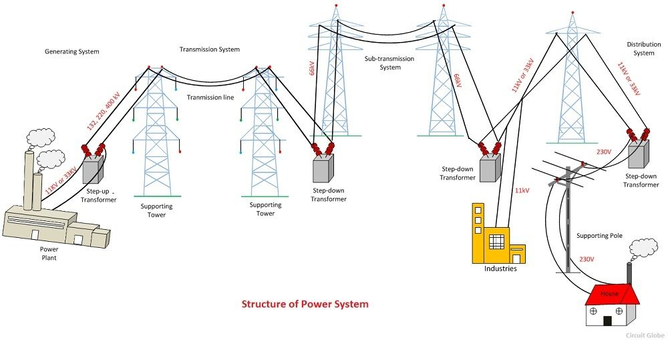
Power System
An electric power systems is a network of electrical components used to supply transmission and used electric power.
DEPARTMENT OF ELECTRONICS AND TELECOMMUNICATION ENGINEERING

Slide 4

Artificial Intelligence
ARTIFICIAL INTELLIGENCE IN POWER STATION
Artificial Intelligence is a branch of Science which deals with helping machines finds solutions to complex problems in a more human-like fashion.

Slide 5
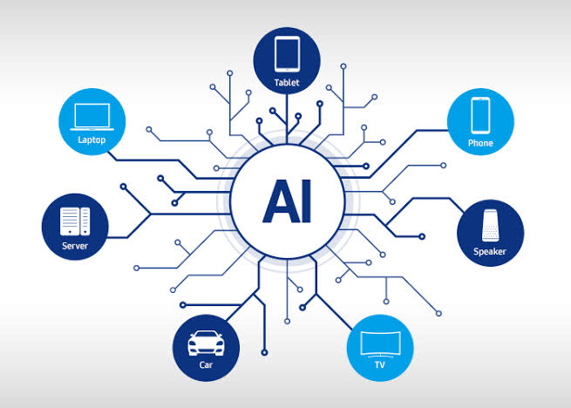
Need for AI in Power Systems
Power system analysis by conventional techniques becomes more difficult because of:
Complex, versatile and large amount of information which
is used in calculation, diagnosis and learning.
DEPARTMENT OF ELECTRONICS AND TELECOMMUNICATION ENGINEERING

Slide 6
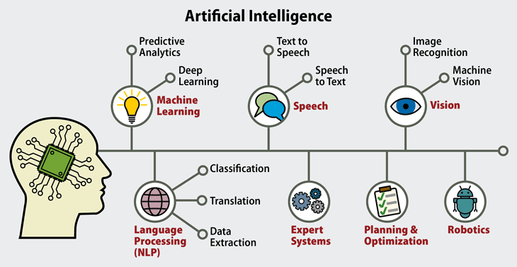
LIMITATIONS OF HUMAN MIND
ARTIFICIAL INTELLIGENCE IN POWER STATION
Object recognition:- People cannot properly explain how they recognize objects.
Face recognition:- Cannot be passed on to another person by explanation.
Naming of colors:- Based on learning, not on absolute standards
DEPARTMENT OF ELECTRONICS AND TELECOMMUNICATION ENGINEERING

Slide 7
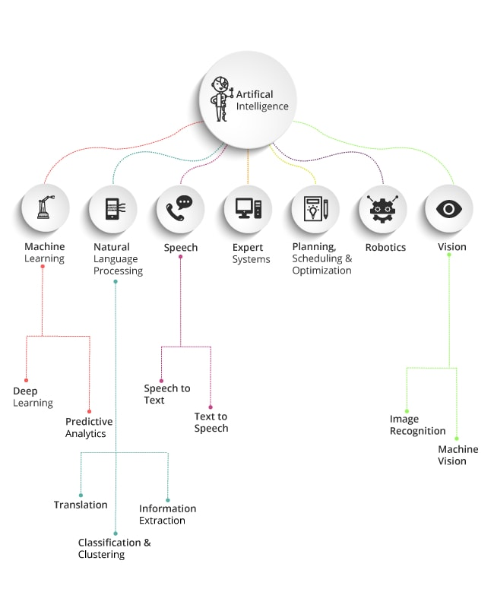
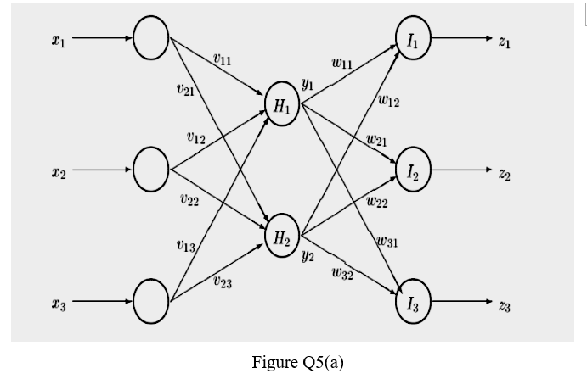
Artificial Intelligence Techniques
Three major families of AI techniques are considered to be applied in modern power system protection
Expert System Techniques (XPSs),
Artificial Neural Networks (ANNs),
Fuzzy logic systems (FL).
DEPARTMENT OF ELECTRONICS AND TELECOMMUNICATION ENGINEERING

Slide 8

Expert Systems
DEPARTMENT OF ELECTRONICS AND TELECOMMUNICATION ENGINEERING

Slide 9
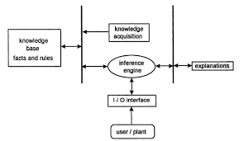
Advantages of Expert systems
It is permanent and consistent.
It can be easily documented.
It can be easily transferred or reproduced.
DEPARTMENT OF ELECTRONICS AND TELECOMMUNICATION ENGINEERING

Slide 10
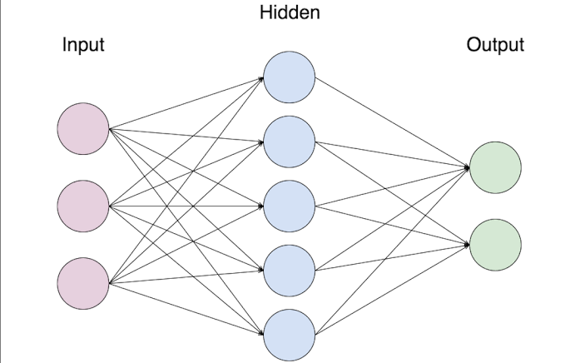
Artificial Neural Netwoks
Artificial neural network are
biologically inspired systems
which convert a set of inputs
into a set of outputs by a
network of neurons, where
each neuron produces one
output as a function of input.
DEPARTMENT OF ELECTRONICS AND TELECOMMUNICATION ENGINEERING

Slide 11
Advantages of ANN
Speed of processing.
They do not need any appropriate knowledge of the system model.
They have ability to handle situation of incomplete data and information corrupt data.
DEPARTMENT OF ELECTRONICS AND TELECOMMUNICATION ENGINEERING

Slide 12
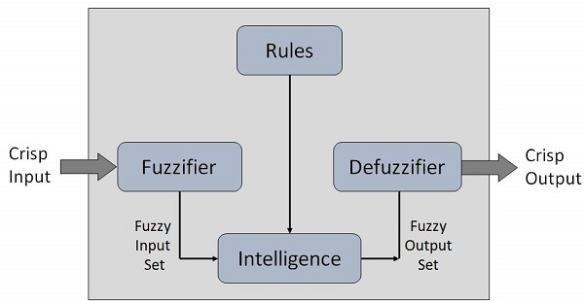
Fuzzy Logic
Fuzzy logic is the way in which human brain works, and we can use this technology in machines so that they can perform somewhat like humans.
It provides expressive power and higher capability to model complex problems.
DEPARTMENT OF ELECTRONICS AND TELECOMMUNICATION ENGINEERING

Slide 13
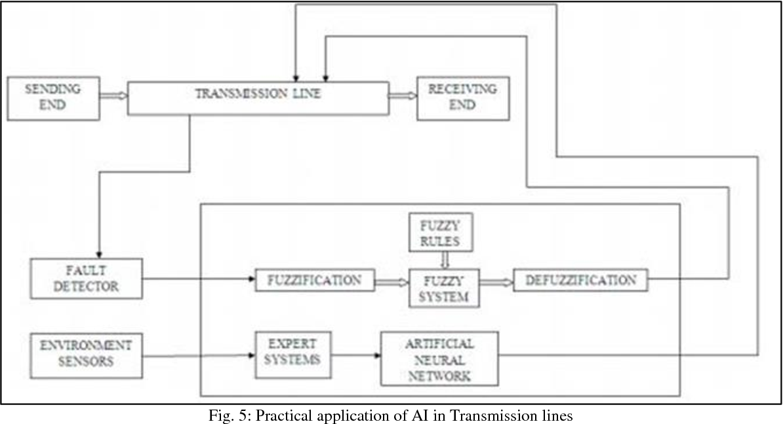
Practical application of AI in transmission line
DEPARTMENT OF ELECTRONICS AND TELECOMMUNICATION ENGINEERING

Slide 14
Applications
AI techniques can be used to improve the performance of transmission line.
Control of power system like voltage control, stability control, power flow control, load frequency control is possible.
Load forecasting.
Fault diagnosis.
Stability analysis and enhancement.
Reactive power planning and its control.
DEPARTMENT OF ELECTRONICS AND TELECOMMUNICATION ENGINEERING

Slide 15
Conclusion
The main feature of power system design and planning is reliability. Conventional techniques don't fulfil the probabilistic essence of power systems. This leads to increase in operating and maintenance costs. Plenty of research is performed to utilize the current interest on Artificial Intelligence for power system applications.
DEPARTMENT OF ELECTRONICS AND TELECOMMUNICATION ENGINEERING

Slide 16
Thank you to all

